Slide 1
Deutsch-Jozsa Algorithm
A demo algo that shows the usefulness of QC
不正经讲师：理科宅Hunt

Slide 2
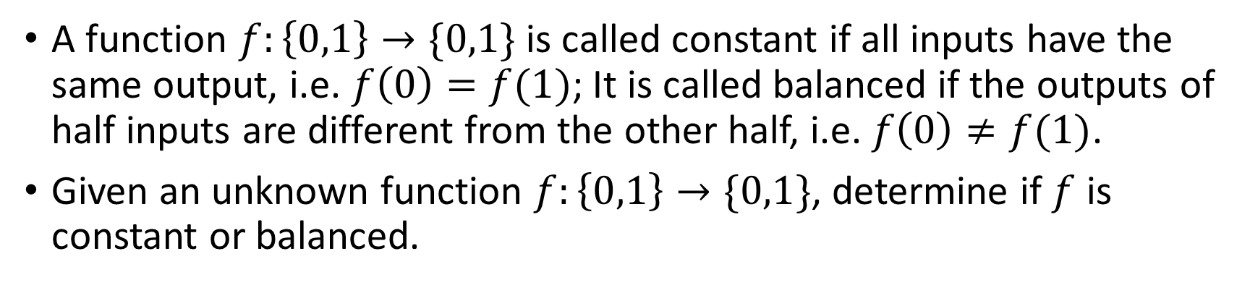
Deutsch Algorithm – Problem Description
A function $f:\left\{0,1\right\}→\{0,1\}$ is called constant if all inputs have the same output, i.e. $f\left(0\right)=f(1)$; It is called balanced if the outputs of half inputs are different from the other half, i.e. $f\left(0\right)≠f(1)$.
Given an unknown function $f:\left\{0,1\right\}→\{0,1\}$, determine if $f$ is constant or balanced.
constant
balanced
0
1
0
0
0
1
0
1
or
or
0
1
1
1
0
1
1
0

Slide 3
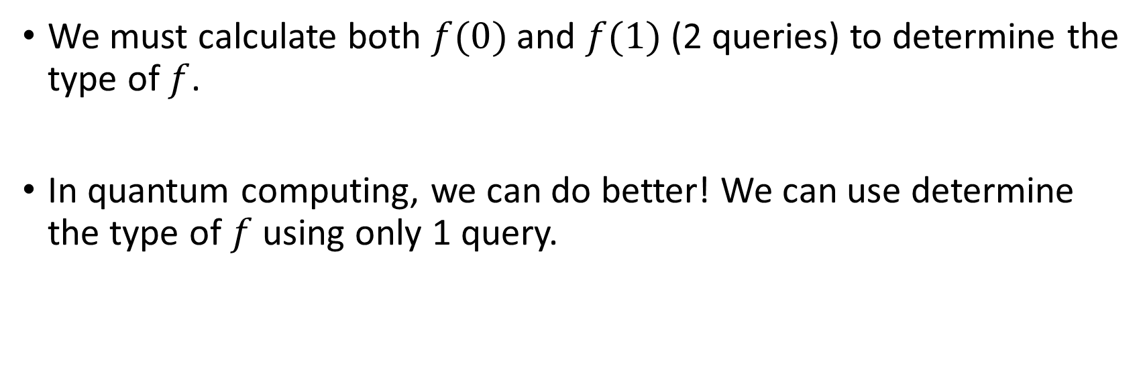
How classical algorithm solve this.
We must calculate both $f(0)$ and $f(1)$ (2 queries) to determine the type of $f$.
In quantum computing, we can do better! We can use determine the type of $f$ using only 1 query.

Slide 4
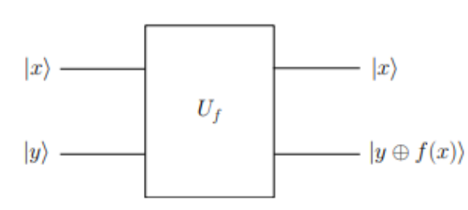







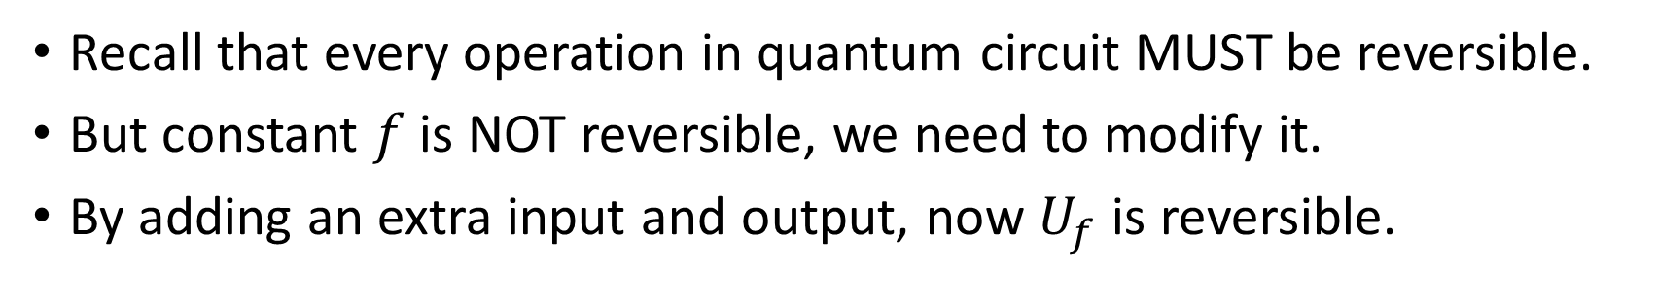
What does $f$ look like in quantum circuit ?
Recall that every operation in quantum circuit MUST be reversible.
But constant $f$ is NOT reversible, we need to modify it.
By adding an extra input and output, now $U_{f}$ is reversible.
$$U_{f}:\left|x\right\rangle \left|y\right\rangle ↦\left|x\right\rangle |y⊕f(x)⟩$$

Slide 5
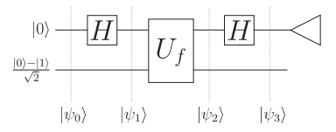
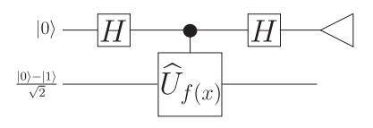
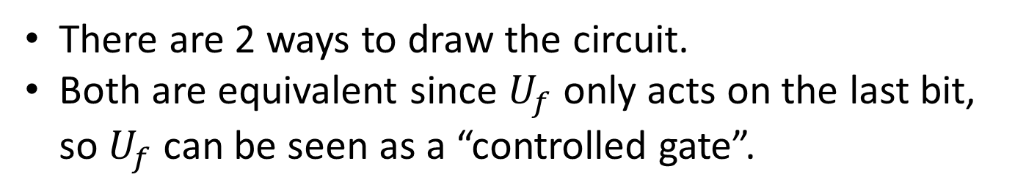

Quantum Circuit
There are 2 ways to draw the circuit.
Both are equivalent since $U_{f}$ only acts on the last bit, so $U_{f}$ can be seen as a “controlled gate”.

Slide 6

Quantum Circuit

Slide 7
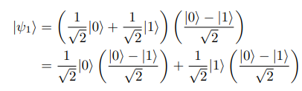
Quantum Circuit

Slide 8
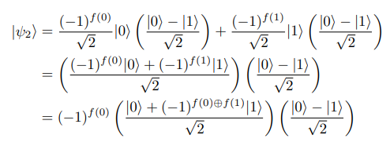


Quantum Circuit
If $f$ is constant, then $f\left(0\right)=f(1)$, so $f\left(0\right)⊕f\left(1\right)=0$
If $f$ is balanced, then $f\left(0\right)≠f(1)$, so $f\left(0\right)⊕f\left(1\right)=1$

Slide 9

Derivation of $|ψ_{2}⟩$

Slide 10







Quantum Circuit
If $f$ is constant
If $f$ is balanced

Slide 11

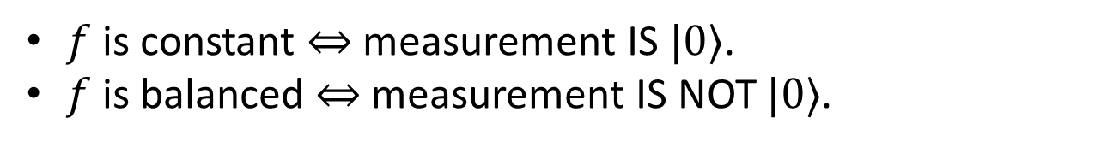


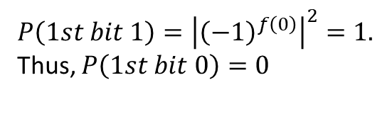
Quantum Circuit
$f$ is constant $⇔$ measurement IS $|0⟩$.
$f$ is balanced $⇔$ measurement IS NOT $|0⟩$.
If $f$ is constant
If $f$ is balanced
$$P(1st bit 0)={\left|{\left(−1\right)}^{f\left(0\right)}\right|}^{2}=1$$
$P\left(1st bit 1\right)={\left|{\left(−1\right)}^{f\left(0\right)}\right|}^{2}=1.$
Thus, $P\left(1st bit 0\right)=0$

Slide 12




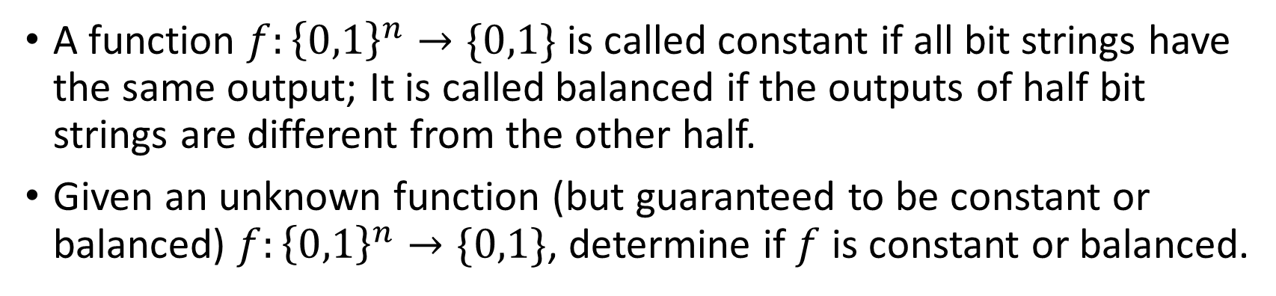
Deutsch-Jozsa Algorithm – Problem Description
A function $f:{\left\{0,1\right\}}^{n}→\{0,1\}$ is called constant if all bit strings have the same output; It is called balanced if the outputs of half bit strings are different from the other half.
Given an unknown function (but guaranteed to be constant or balanced) $f:{\left\{0,1\right\}}^{n}→\{0,1\}$, determine if $f$ is constant or balanced.
constant
balanced
$$x$$
$$0$$
$$x$$
half 0s half 1s
or
$$x$$
1

Slide 13
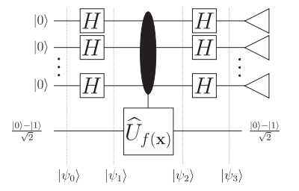
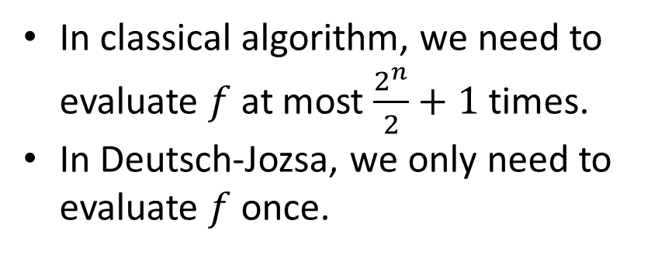





Quantum Circuit
In classical algorithm, we need to evaluate $f$ at most $\frac{2^{n}}{2}+1$ times.
In Deutsch-Jozsa, we only need to evaluate $f$ once.
$$U_{f}:\left|x\right\rangle \left|y\right\rangle ↦\left|x\right\rangle |y⊕f(x)⟩$$

Slide 14

Quantum Circuit

Slide 15




Hadamard gate on bit string
Derive formula:
We can prove this using the following hint:

Slide 16

Quantum Circuit
A useful formula:
We can prove this using the following hint:

Slide 17
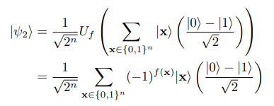
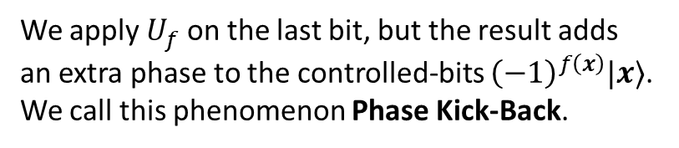
Quantum Circuit
We apply $U_{f}$ on the last bit, but the result adds an extra phase to the controlled-bits ${\left(−1\right)}^{f\left(x\right)}|x⟩$. We call this phenomenon Phase Kick-Back.

Slide 18






Quantum Circuit

Slide 19
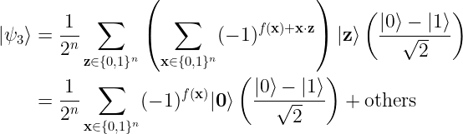





Quantum Circuit
It seems quite complicated, but it can be simplified.
Let’s look at the situation when $\left|z\right\rangle =|0⟩$.
If $f$ is constant
If $f$ is balanced

Slide 20


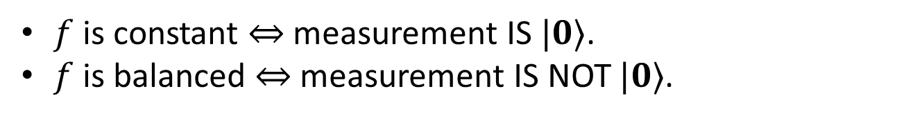
Quantum Circuit
$f$ is constant $⇔$ measurement IS $|0⟩$.
$f$ is balanced $⇔$ measurement IS NOT $|0⟩$.
If $f$ is constant
If $f$ is balanced

Slide 21
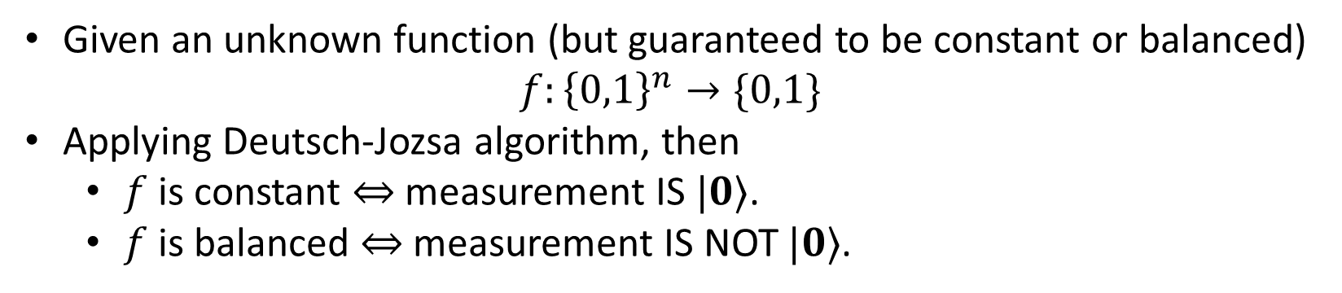
Summary
Given an unknown function (but guaranteed to be constant or balanced)
$$f:{\left\{0,1\right\}}^{n}→\{0,1\}$$
Applying Deutsch-Jozsa algorithm, then
$f$ is constant $⇔$ measurement IS $|0⟩$.
$f$ is balanced $⇔$ measurement IS NOT $|0⟩$.

